Slide 1
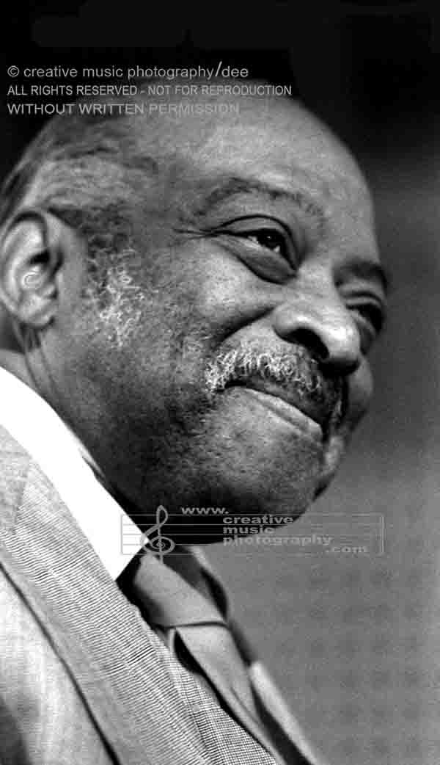
Count Basie

Slide 2
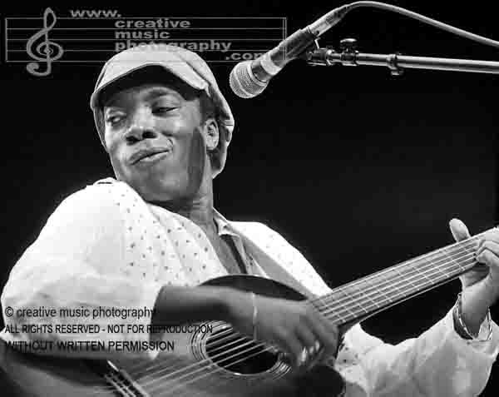
Milton Nascimento

Slide 3
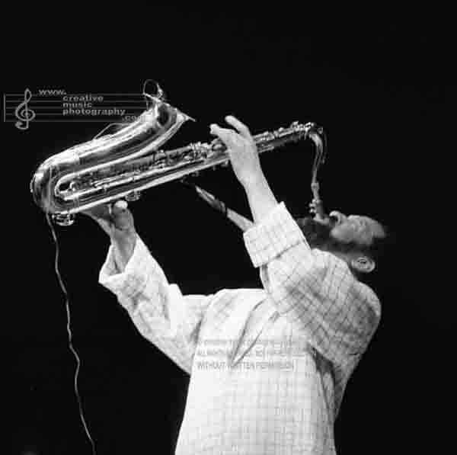
Sonny Rollins

Slide 4
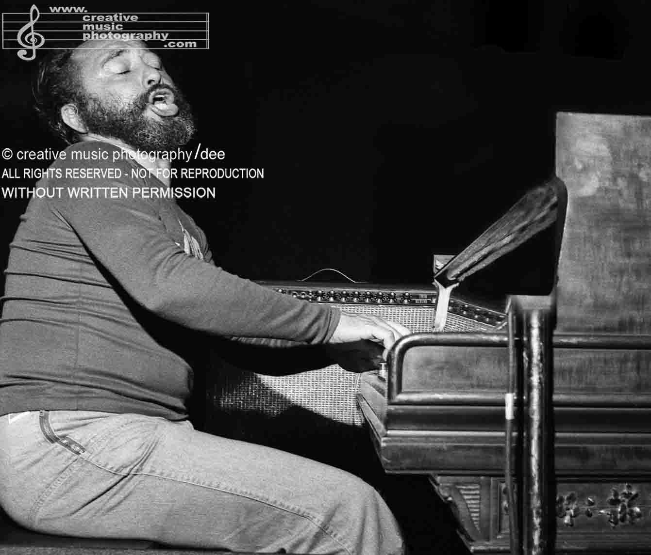
Eddie Palmieri

Slide 5
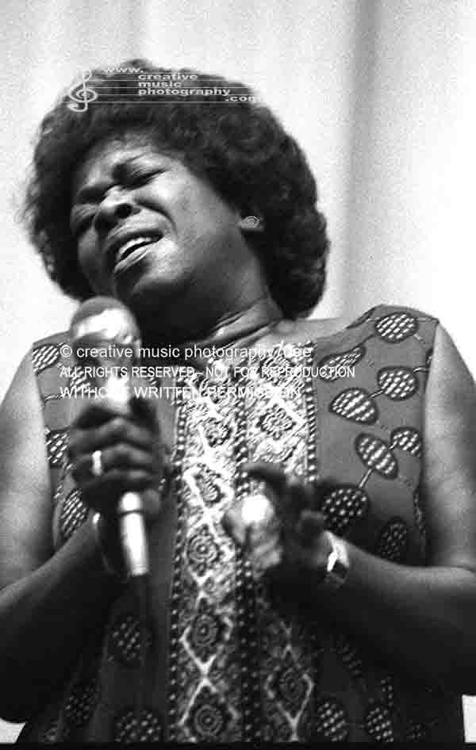
Sarah Vaughan

Slide 6
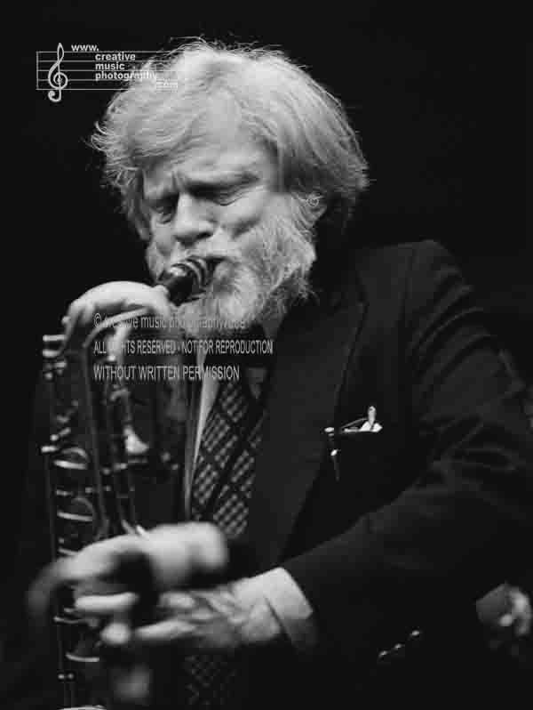
Gerry Mulligan

Slide 7
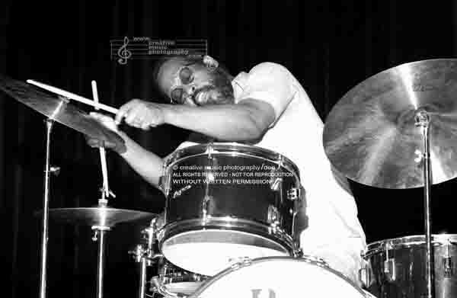
Steve McCall
Steve McCall

Slide 8
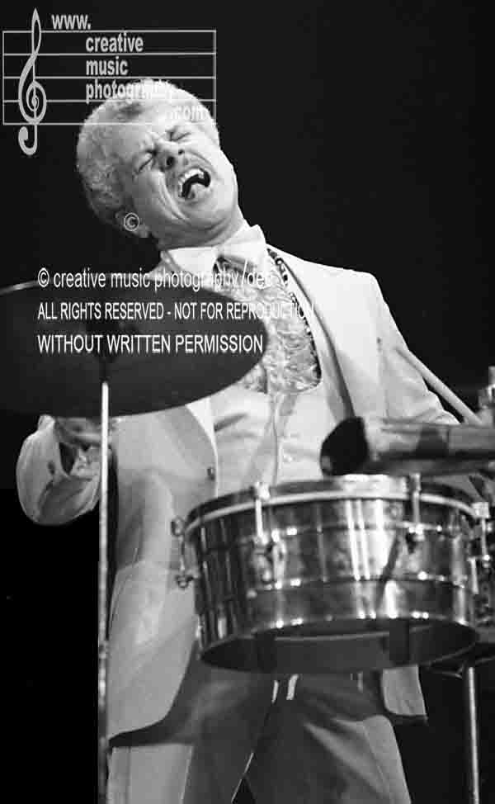
Tito Puente

Slide 9
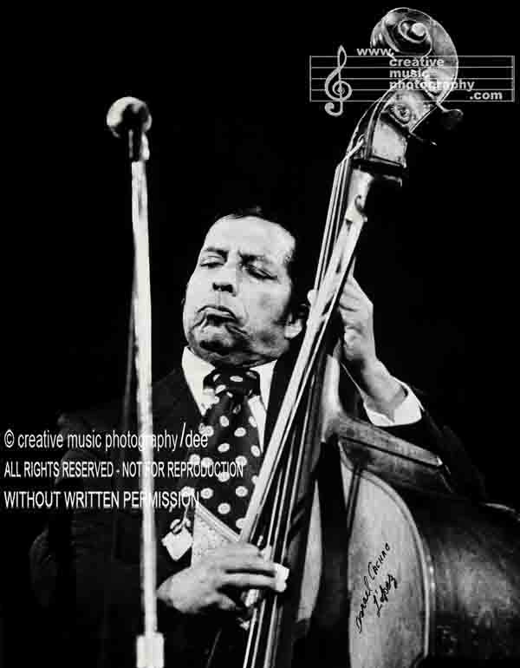
Israel ‘Cachao’ López

Slide 10
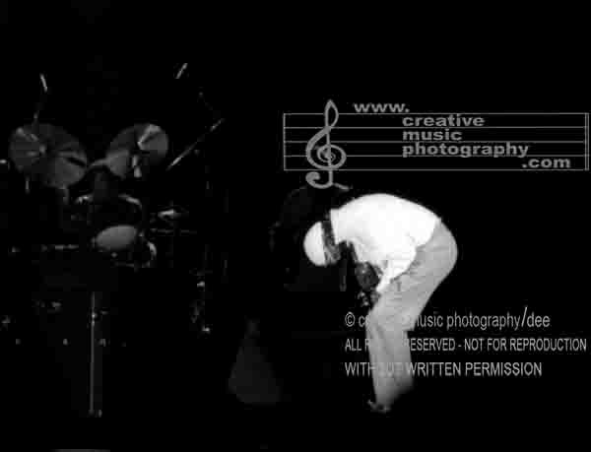
Miles Davis

Slide 11
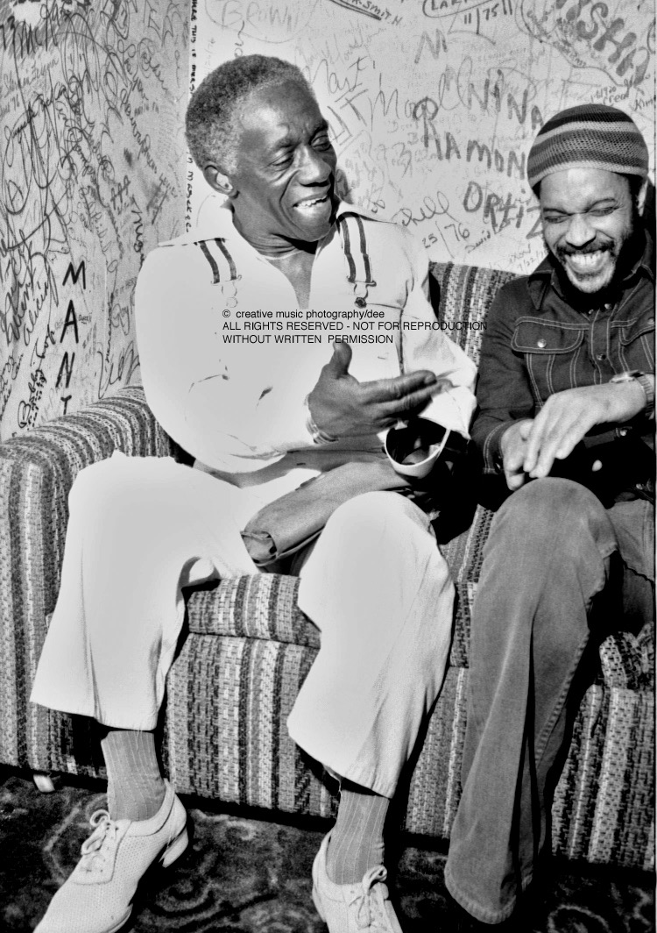
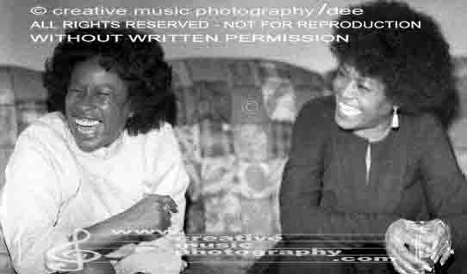
ART BLAKEY
BILLY HIGGINS
ABBEY LINCOLN
BETTY CARTER

Slide 12
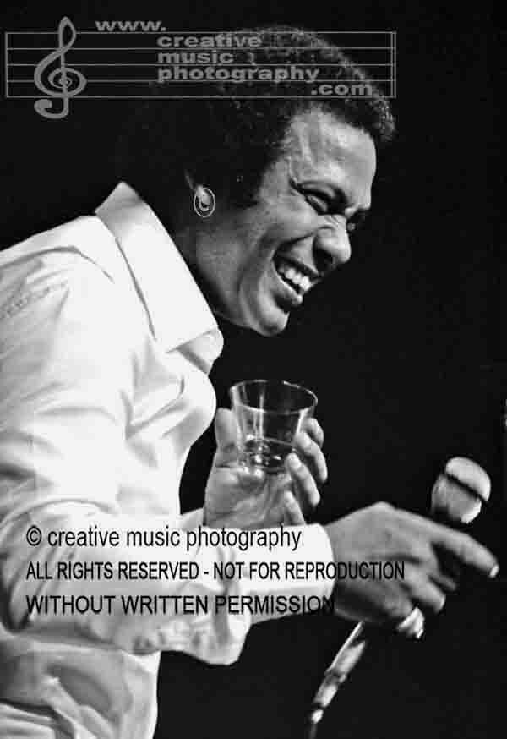
José ‘Cheo’ Feliciano

Slide 13
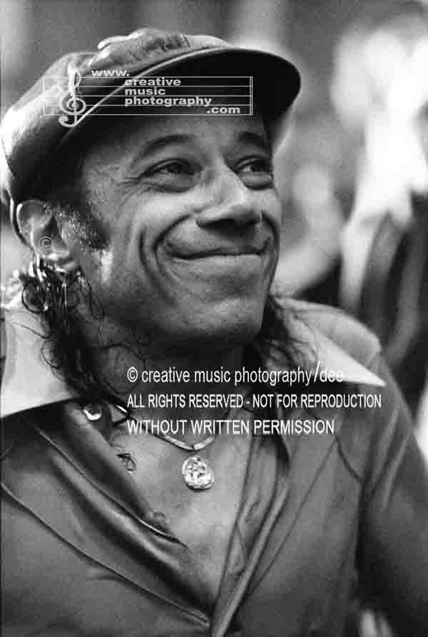
Horace Silver

